Slide 1


K.RAMAKRISHNAN COLLEGE OF TECHNOLOGY (AUTONOMOUS), TRICHY
Simple Regression Model to Predict Monthly Pocket Money Expenses
PRESENTED BY
NEKASHRI S-2303811724322073

Slide 2
PRESENTATION OVERVIEW
PROBLEM IDENTIFICATION
OBJECTIVE
BLOCK DIAGRAM OF PROPOSED SYSTEM
R STRUCTURE USED
MODULES OF THE SYSTEM
IMPLEMENTATION
OUTPUT
ADVANTAGES OF PROPOSED SYSTEM
CONCLUSION

Slide 3
PROBLEM IDENTIFICATION
Many students and individuals receive pocket money but lack a proper system to track their expenses, leading to inefficient spending habits.
Most individuals do not analyse their spending behavior, resulting in overspending or under-budgeting.
Monthly spending patterns vary due to unexpected expenses, social events, or seasonal changes, making budgeting difficult.
2/7/20

Slide 4
OBJECTIVE
Develop an interactive system to predict monthly pocket money expenses.
Use key factors such as income, age, and savings to build a predictive model.
Allow users to upload financial datasets and view visualisations and summaries.
Help students, researchers, and planners gain insights and improve financial decision-making

Slide 5
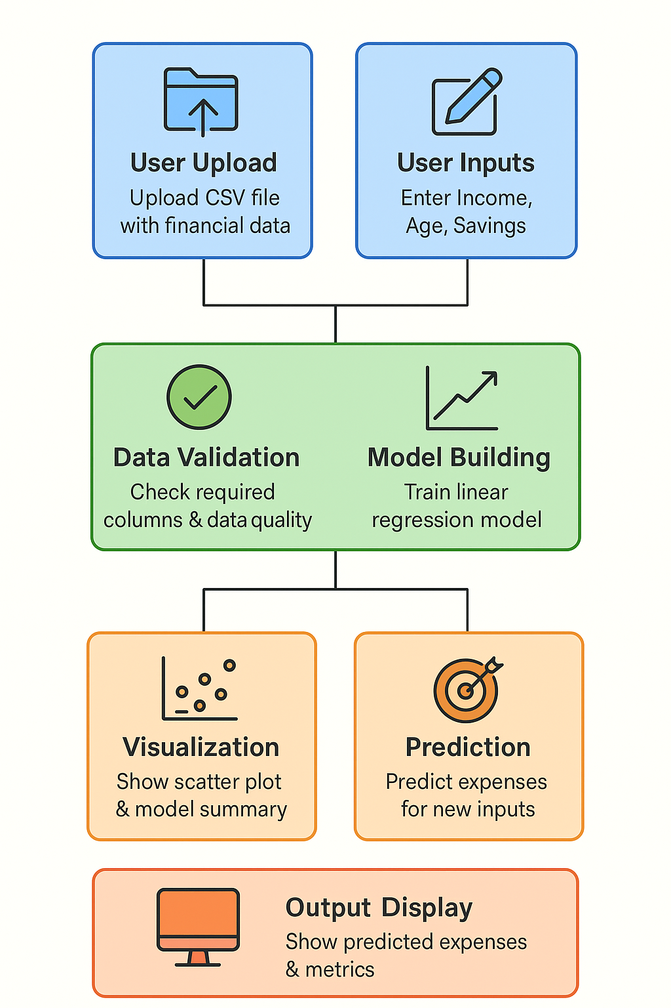
BLOCK DIAGRAM OF PROPOSED SYSTEM

Slide 6
  R STRUCTURE USED
Data Frame (data.frame) – Stores tabular data, including income, age, savings, expenses, and category for multiple individuals.
New Data Frame – Created separately to store user inputs for making predictions.
Numeric Vector (numeric) – Handles continuous values like income, age, savings, and expenses, ensuring proper data processing.

Slide 7
  R STRUCTURE USED
Character Vector (character) – Stores text-based data such as names and expense categories.
Factor (factor) – Categorizes expenses to improve statistical modeling and visualization.

Slide 8
LIST OF MODULES
Data Collection Module
Data Preprocessing Module
Prediction Module
Model Evaluation Module
Data Visualisation Module

Slide 9
MODULES OF THE SYSTEM
Data Collection Module – Allows users to upload a CSV file containing historical pocket money data, including Income, Age, Savings, and Expenses.
Data Preprocessing Module – Validates the uploaded data, and ensures the data is clean and numeric for regression analysis.
Prediction Module – Builds and trains a linear regression model to forecast monthly Expenses based on the user's Income, Age, and Savings inputs.

Slide 10
MODULES OF THE SYSTEM
Model Evaluation Module – Calculates and displays performance metrics like Root Mean Squared Error (RMSE) and R² score to evaluate the model’s accuracy.
Data Visualization Module – Uses scatter plots with regression lines to show the relationship between Income and Expenses, helping to identify trends.

Slide 11
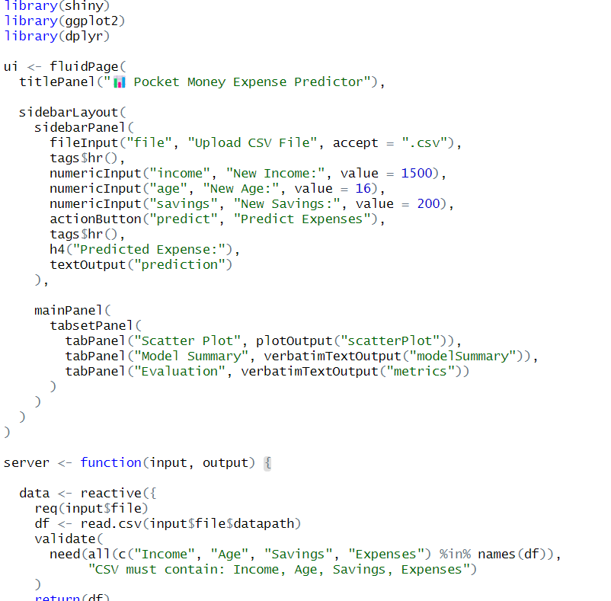
IMPLEMENTATION

Slide 12
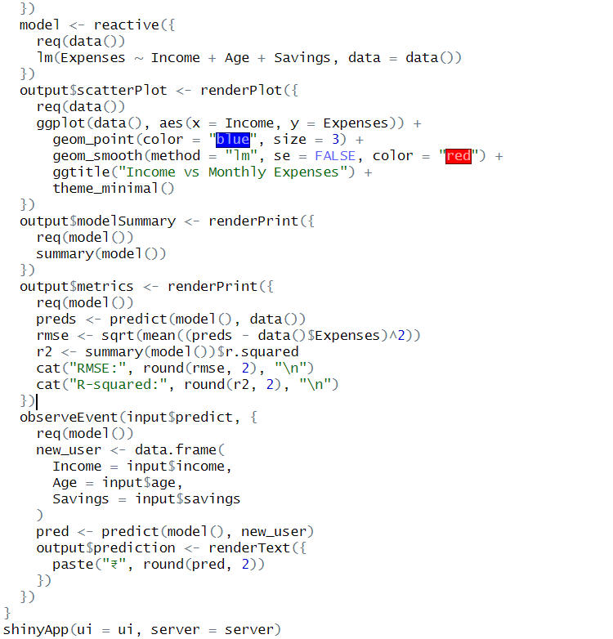
IMPLEMENTATION

Slide 13
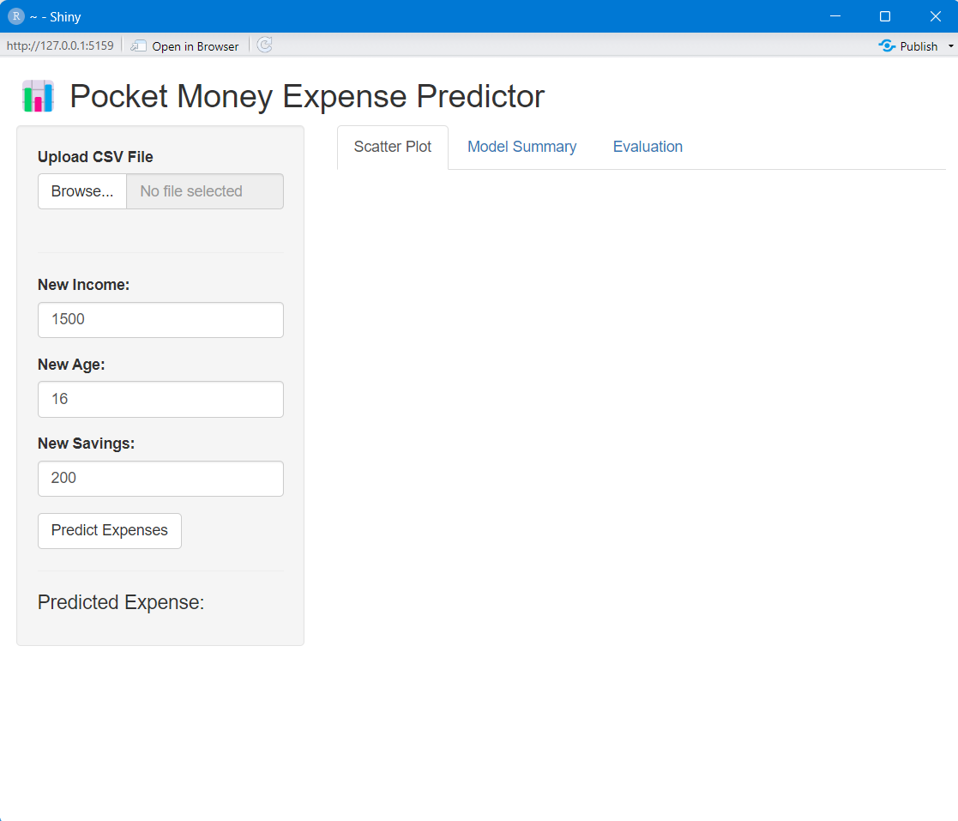
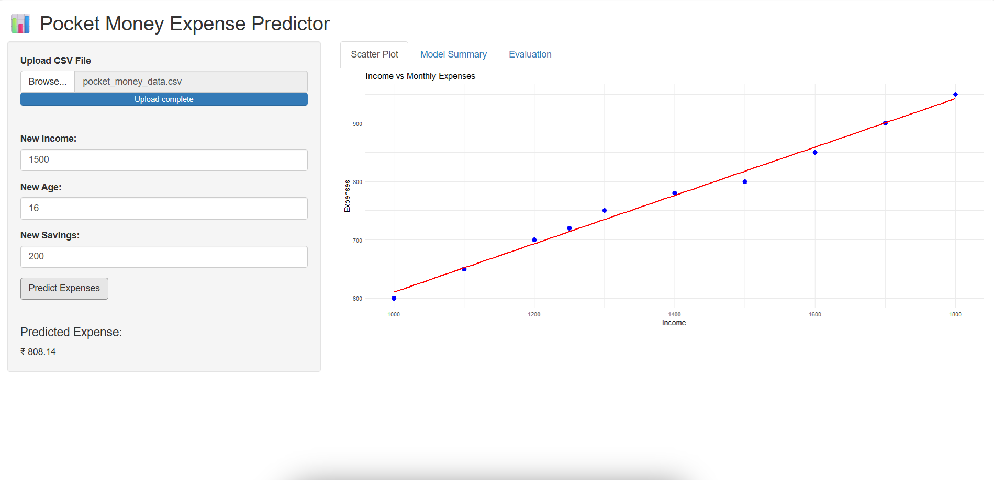
OUTPUT

Slide 14
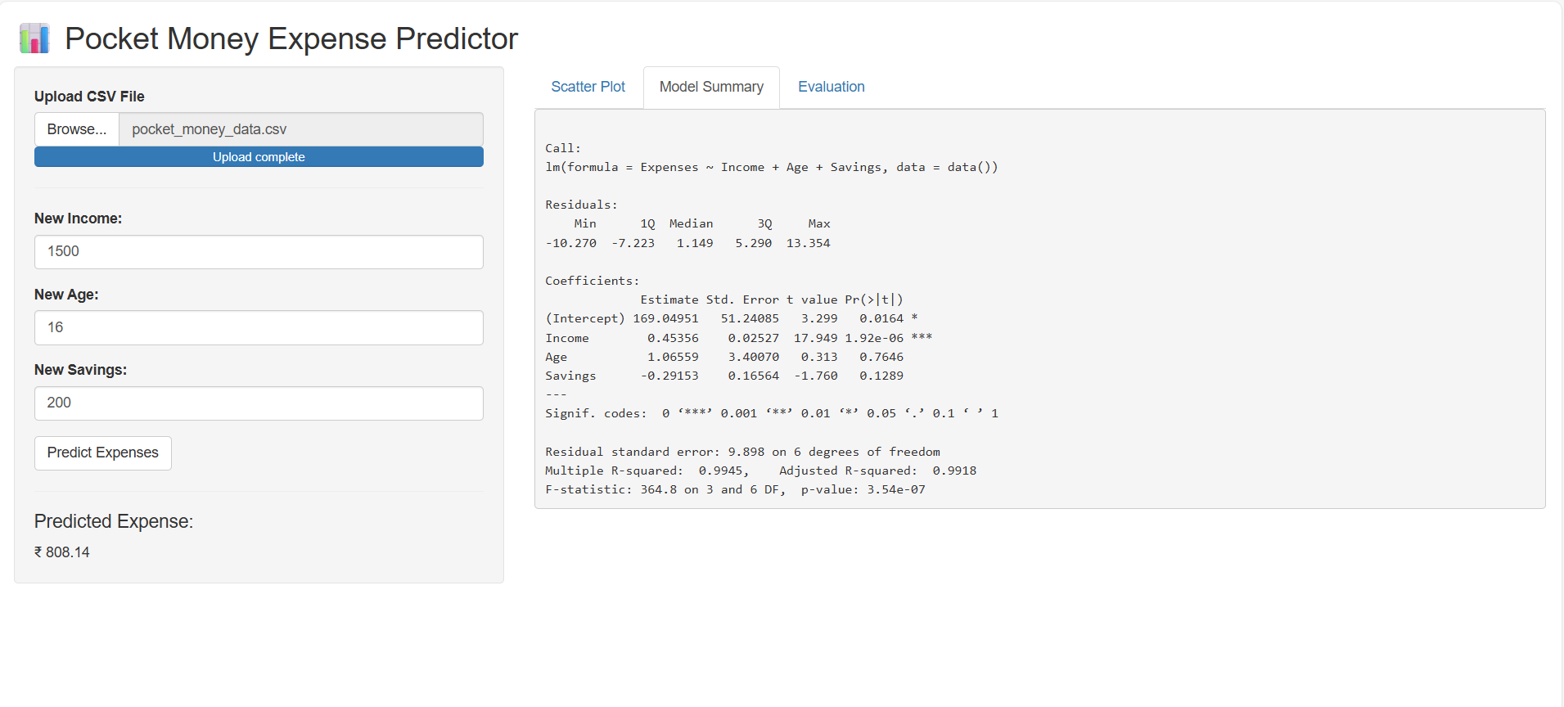
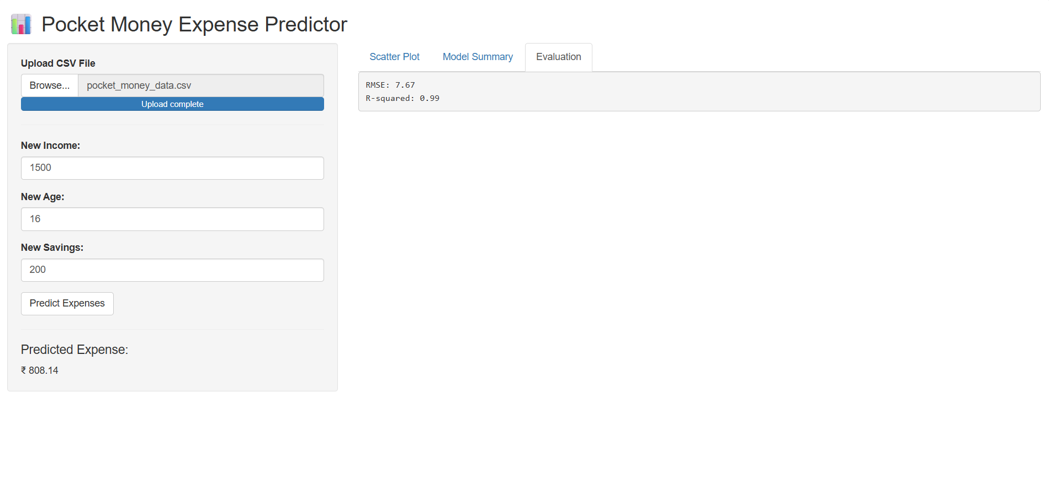
OUTPUT

Slide 15
ADVANTAGES OF PROPOSED SYSTEM
Accurate Prediction: Estimates monthly pocket money expenses using a data-driven model.
Cost-Effective: Built with free, open-source R software; runs on basic systems.
Better Decision Making: Offers insights into spending habits to help plan budgets.
Customizable: Can include more factors like inflation or savings goals.
Extendable: Easily upgraded to advanced models like multiple regression or ML.

Slide 16
Conclusion
The model's accuracy is evaluated using RMSE and R² metrics, helping users understand the reliability of the predictions.
Visualization through scatter plots provides clear insight into the relationship between income and expenses.
This application can be a useful tool for students and parents to plan and manage pocket money more effectively.

Slide 17


